Slide 1

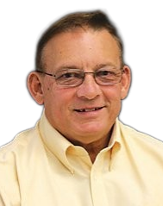

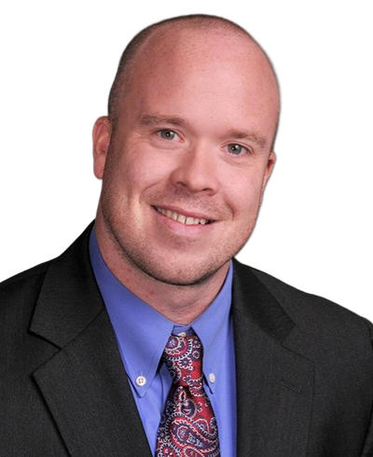
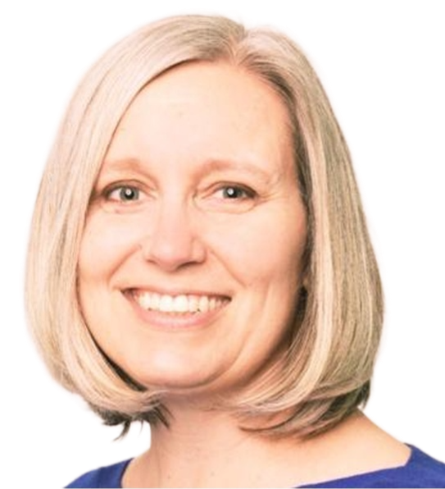

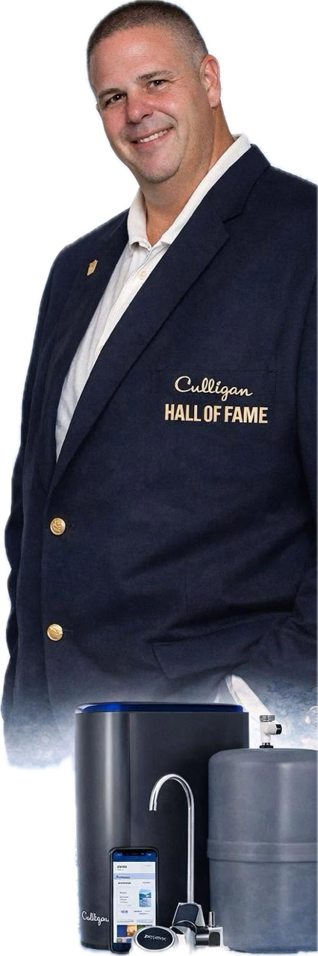







Monthly Meeting June 2026
“The Power of Civic Engagement”
Connecting, Serving, and Leading
PANELISTS
Jerry Spessard
Hagerstown
Rotary Club
Past President
Jim McCleaf
Alsatia Club, Inc.
Past President and Current Treasurer
Darrell Evans
Antietam Exchange Club of Hagerstown
President
Katie Clark
Kiwanis Club of Hagerstown
Vice President
Tim Foltz
Hagerstown
Lion’s Club
International Foundation Coordinator
Brad Kegarise
Downsville
Ruritan Club
President

Slide 2
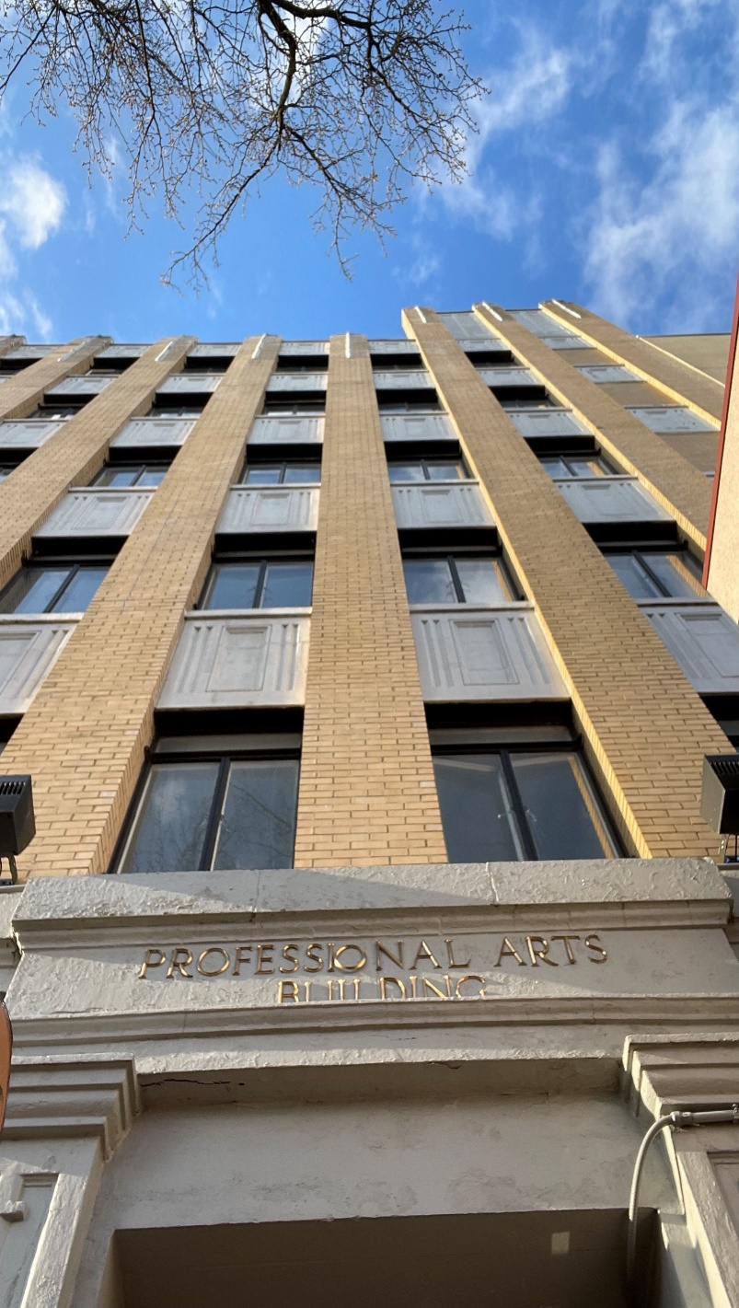



Welcome
GHC Monthly Meeting
June 2026
Tereance Moore
GHC Chair

Slide 3

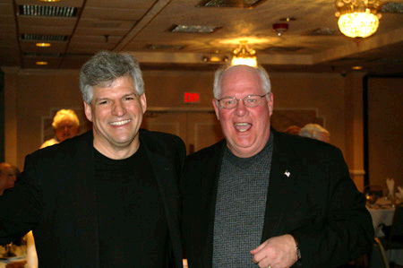
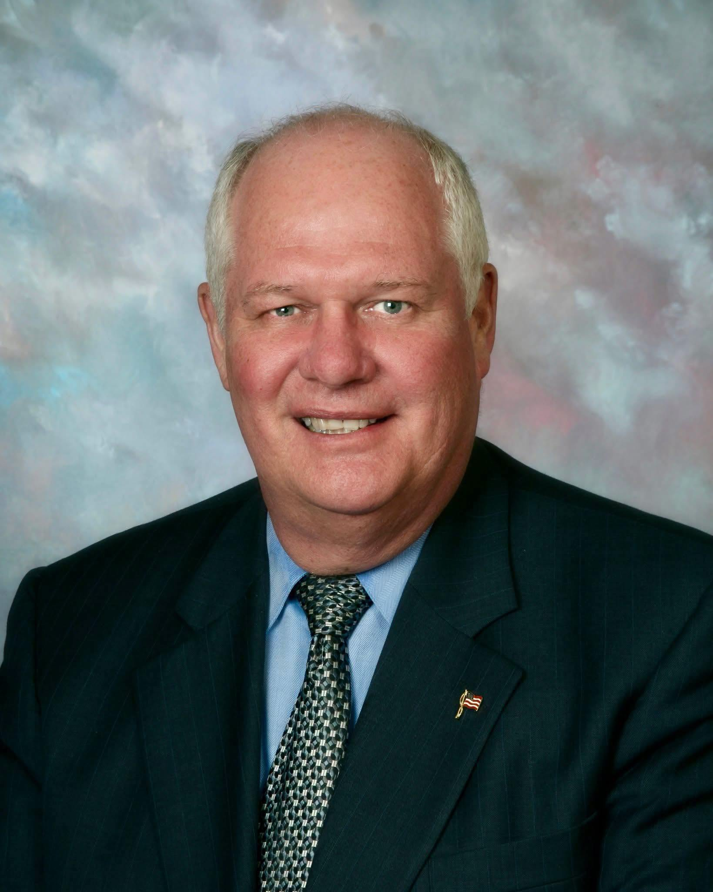
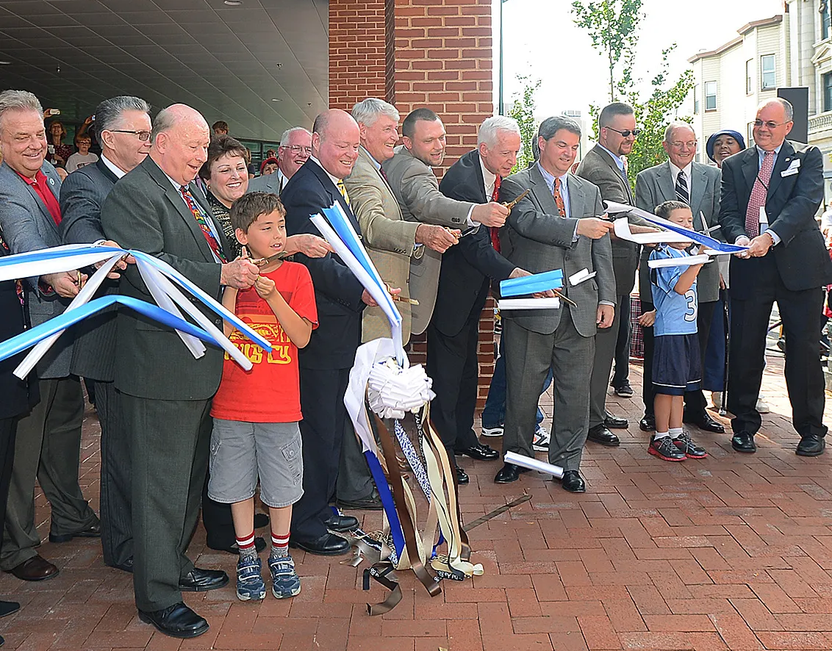
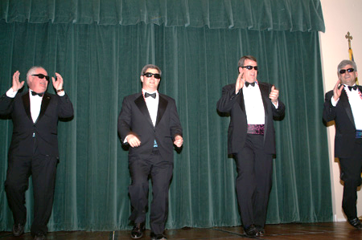
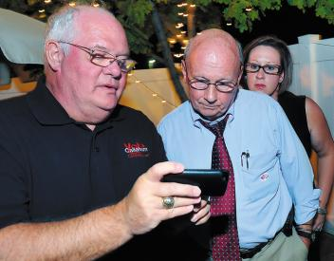
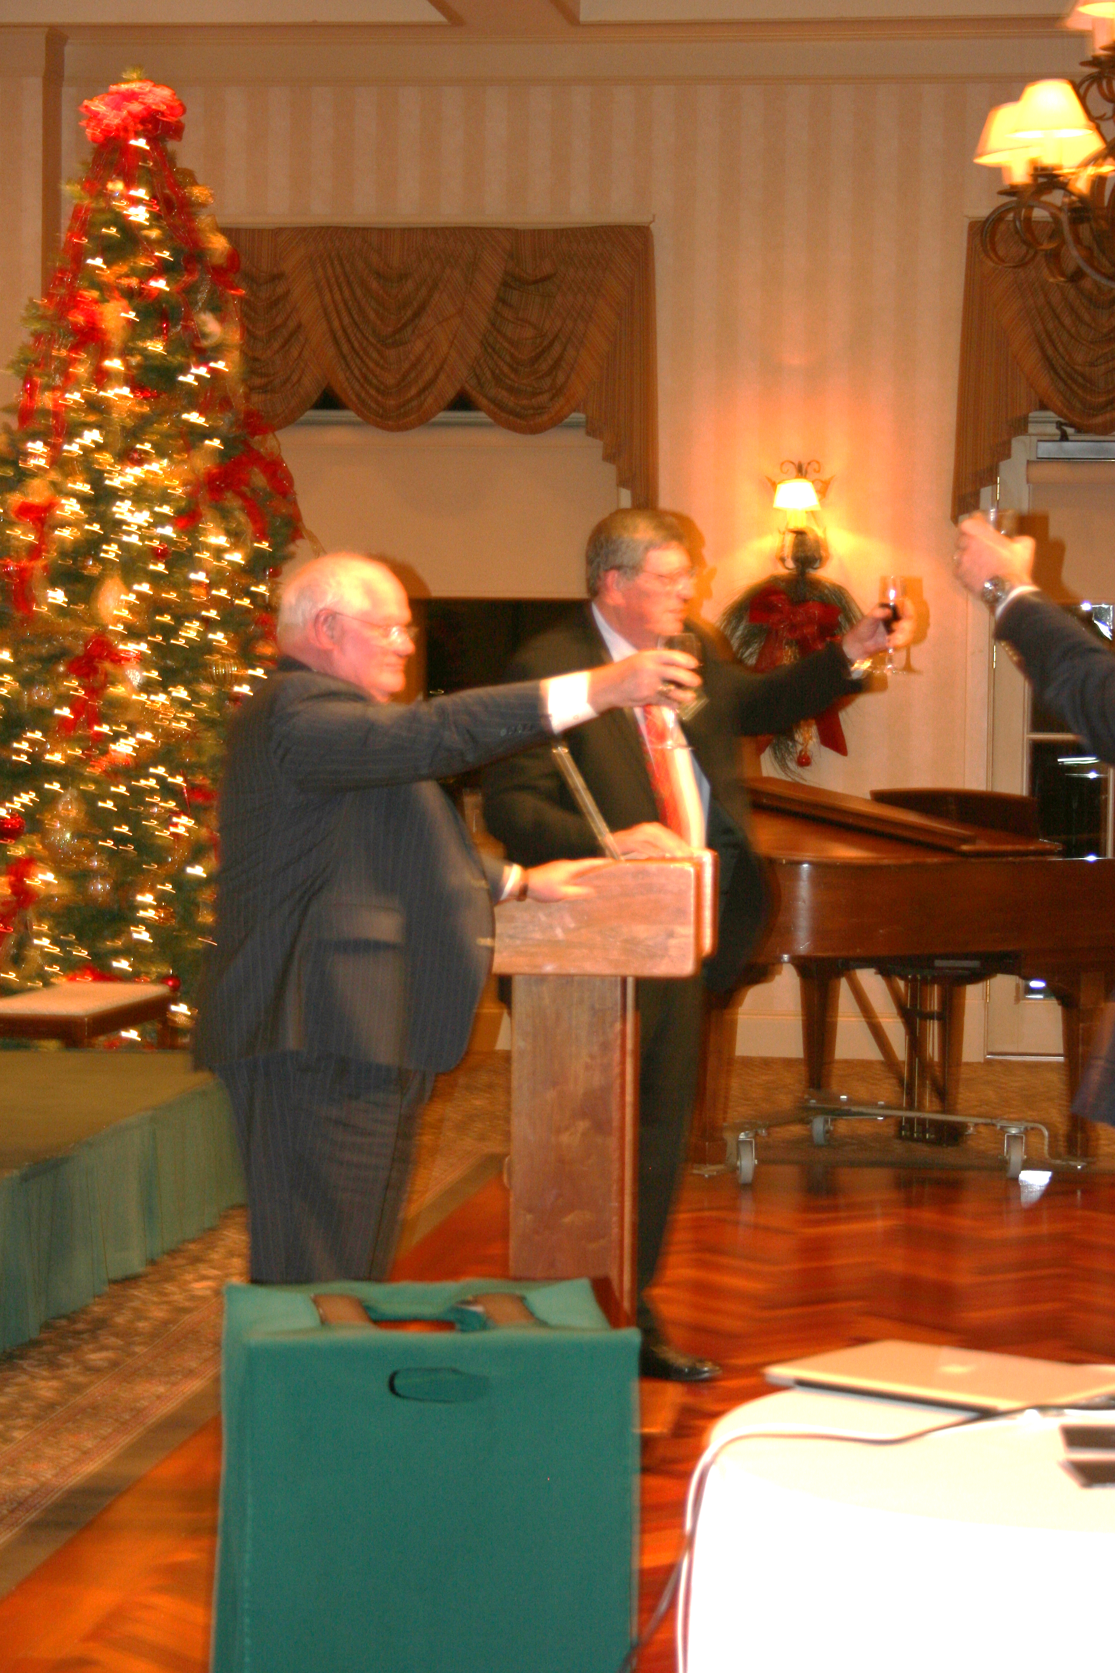
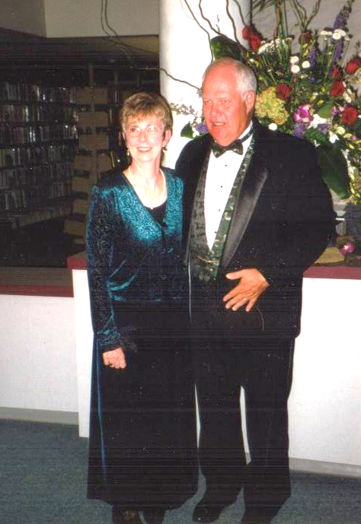
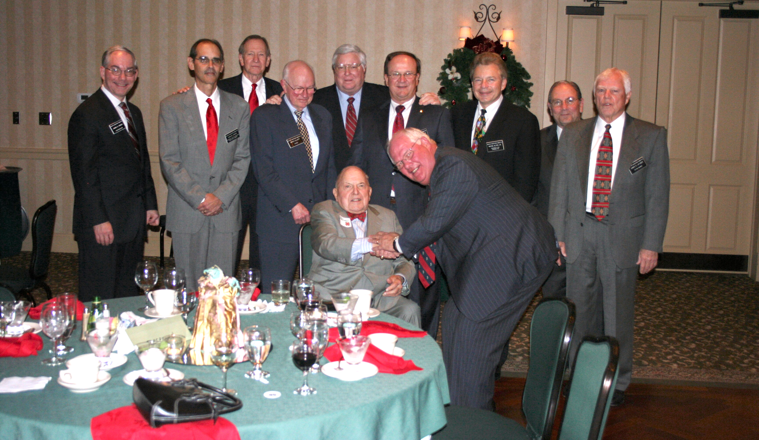
In Loving Memory
Art Callaham
October 19, 1948 – June 18, 2026
GHC Executive Director 1998-2010

Slide 4

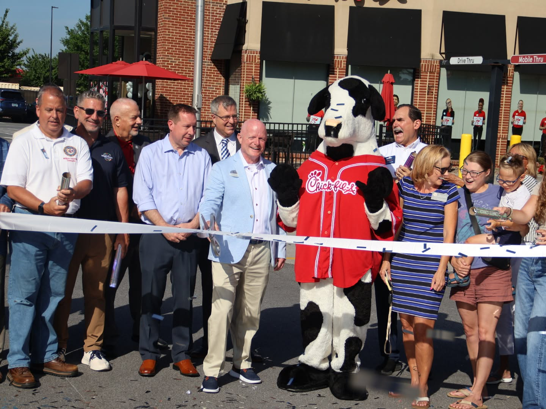
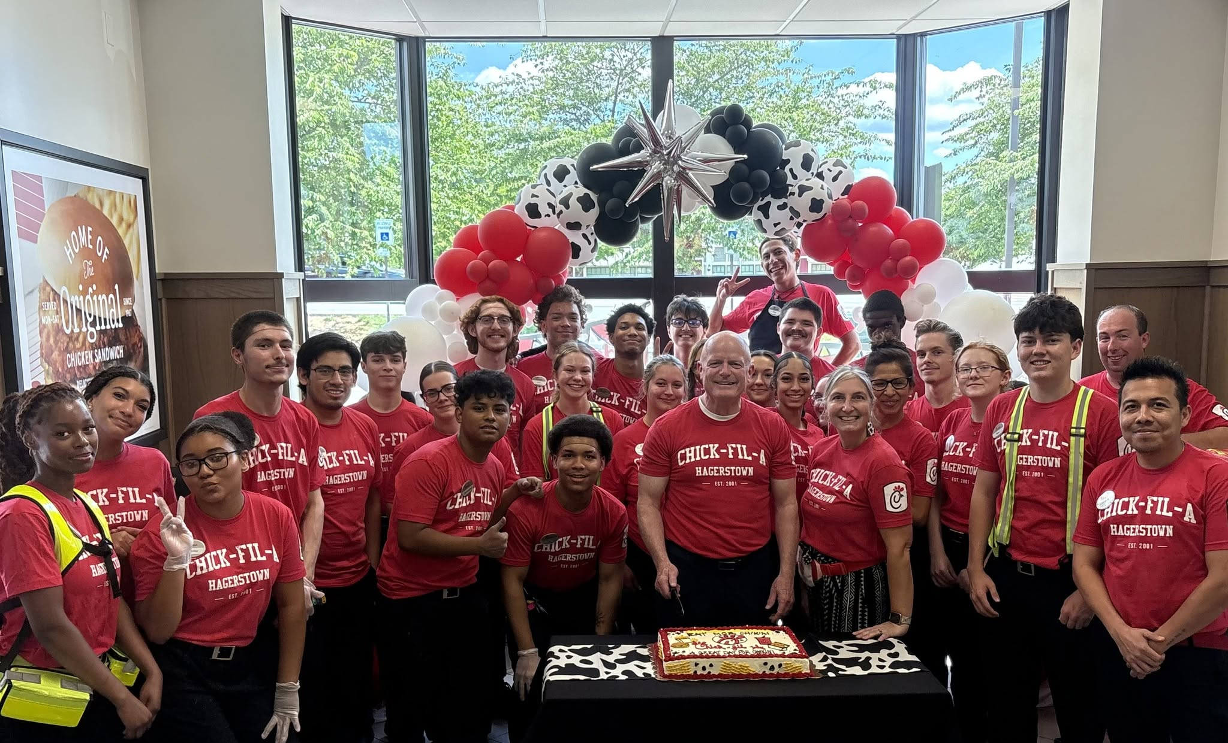
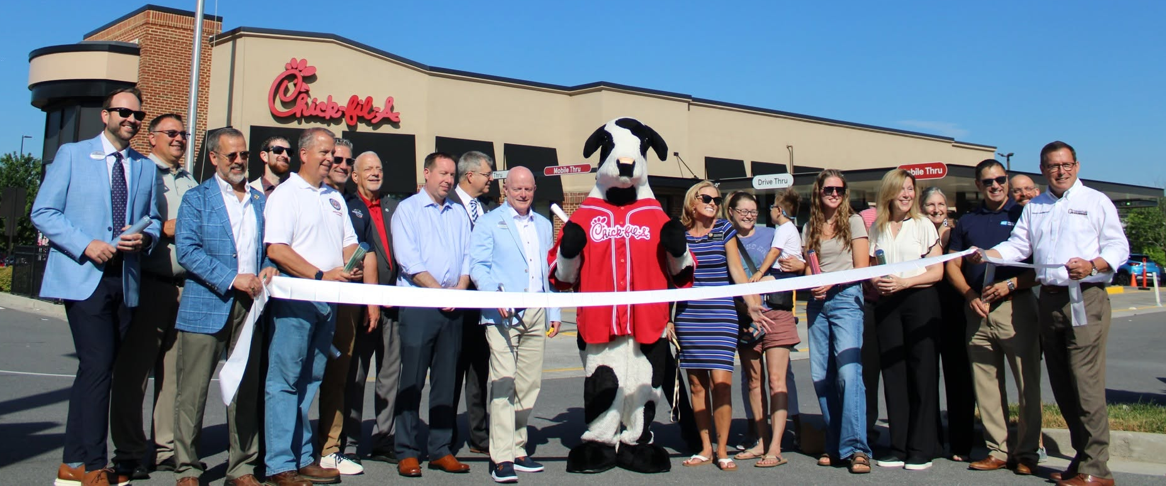
GHC Monthly Meeting June 2026
Congratulations

Slide 5

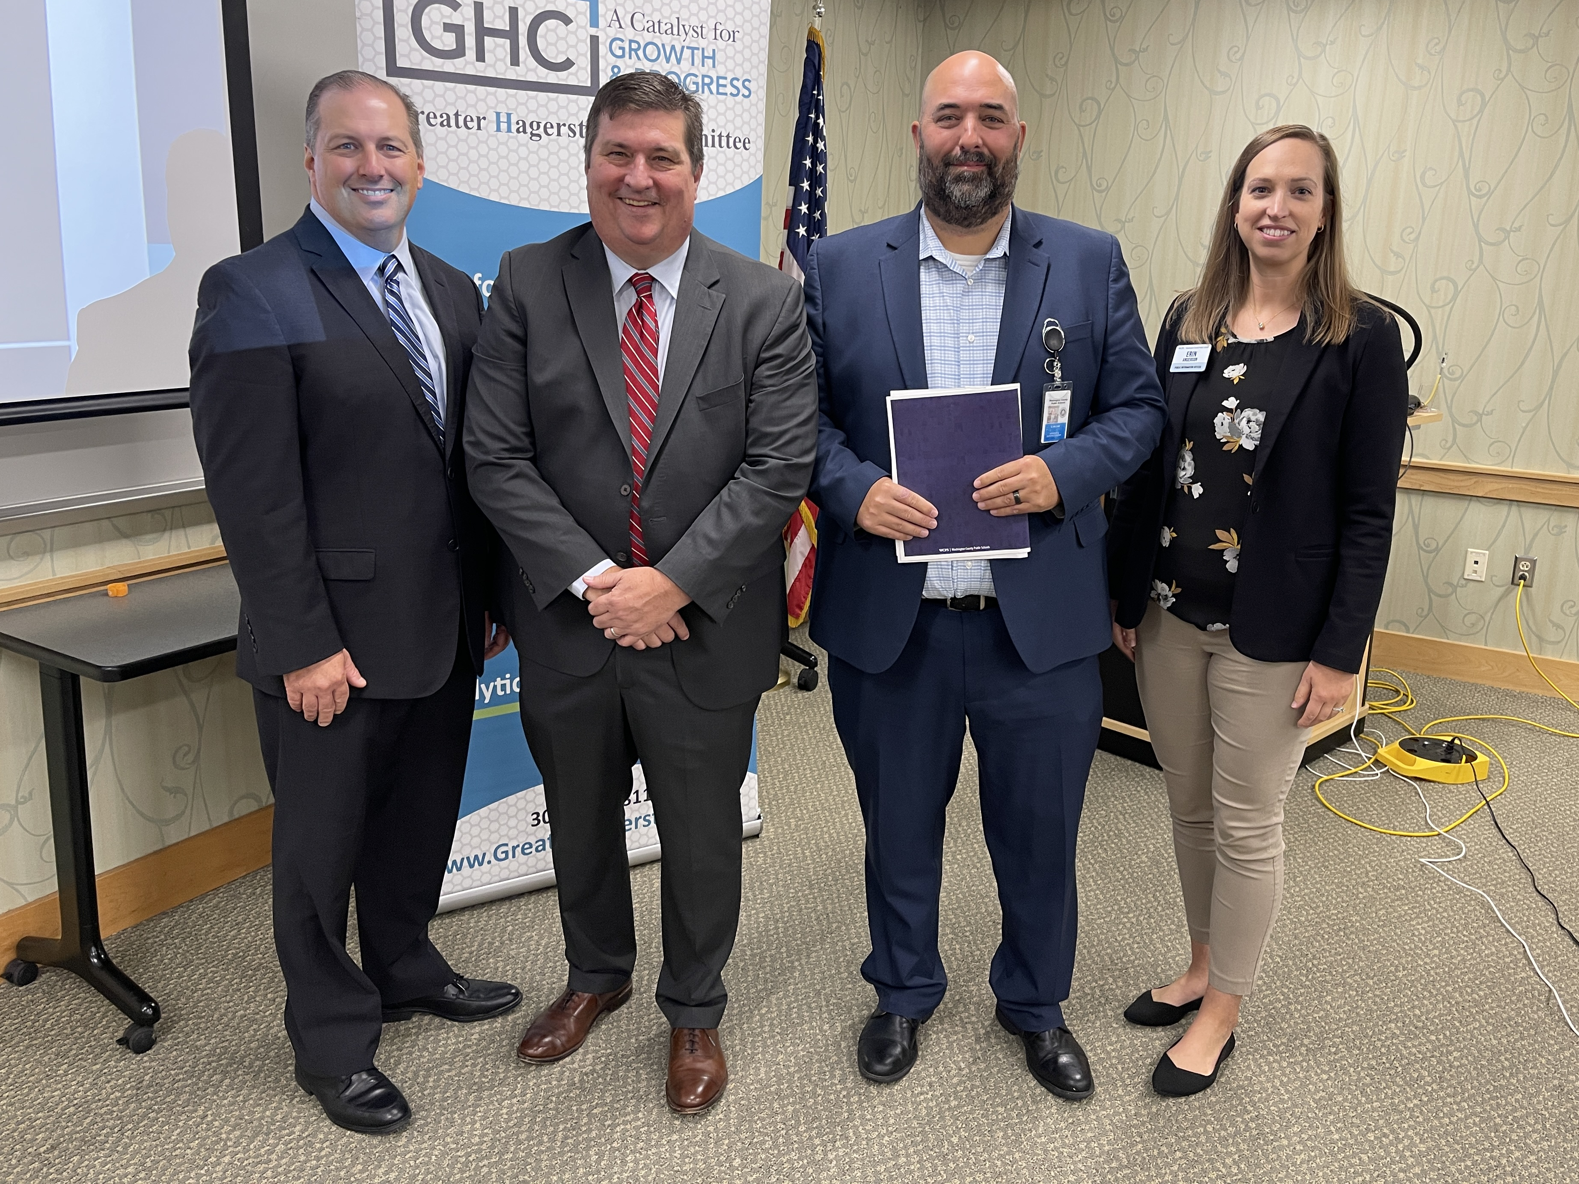
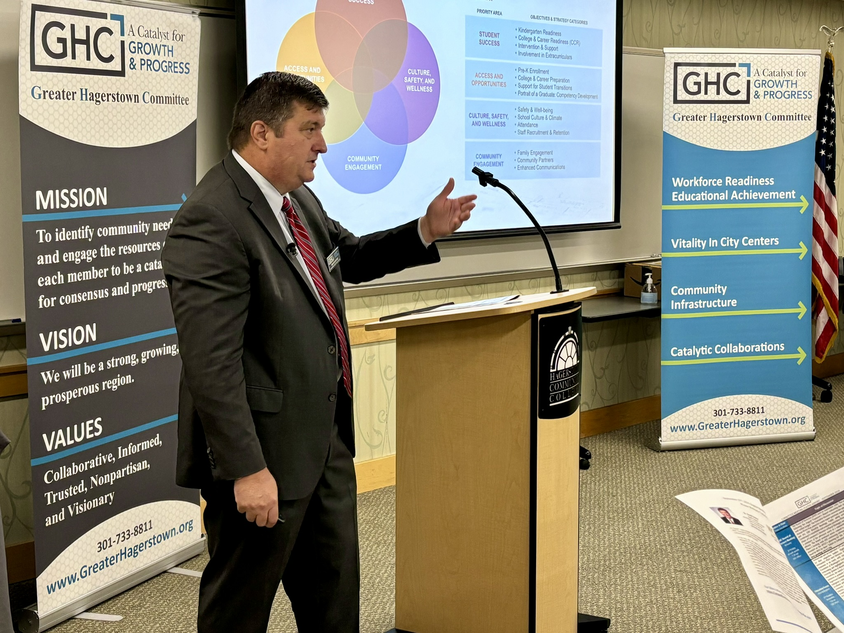
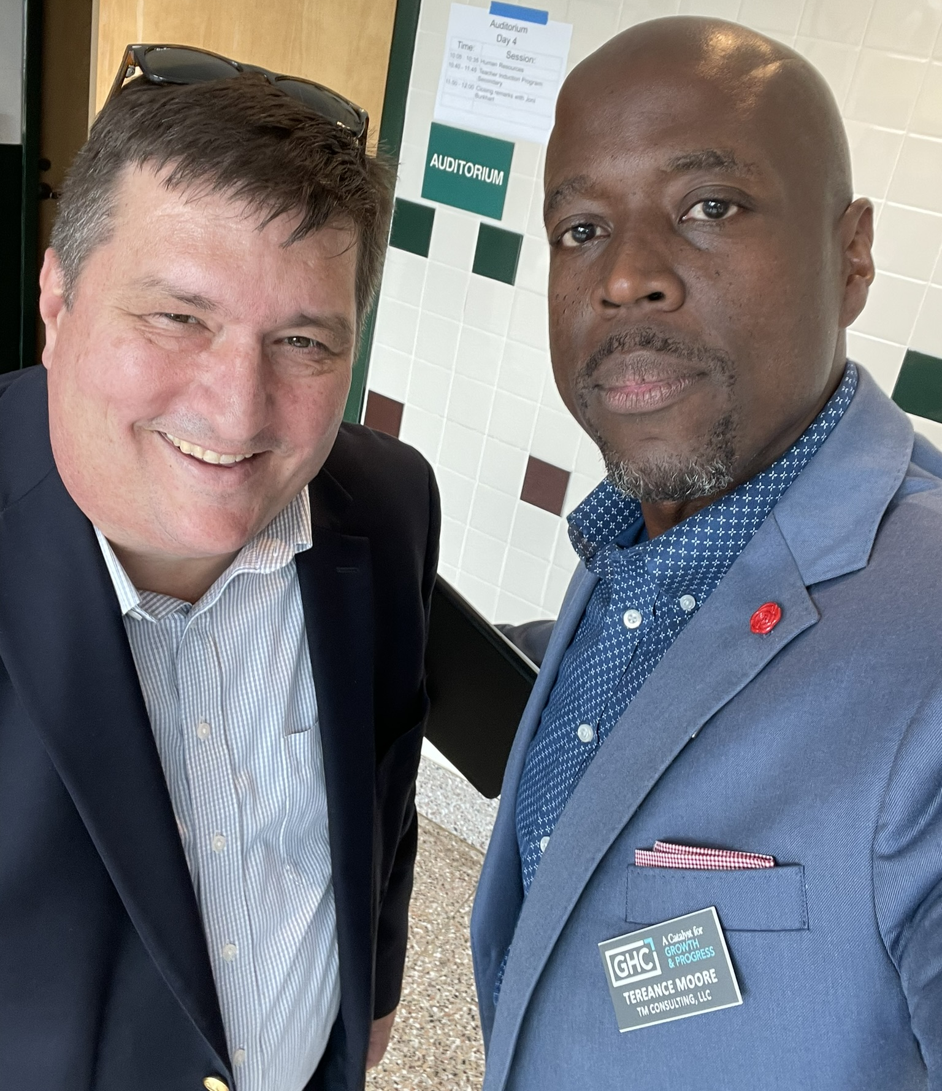
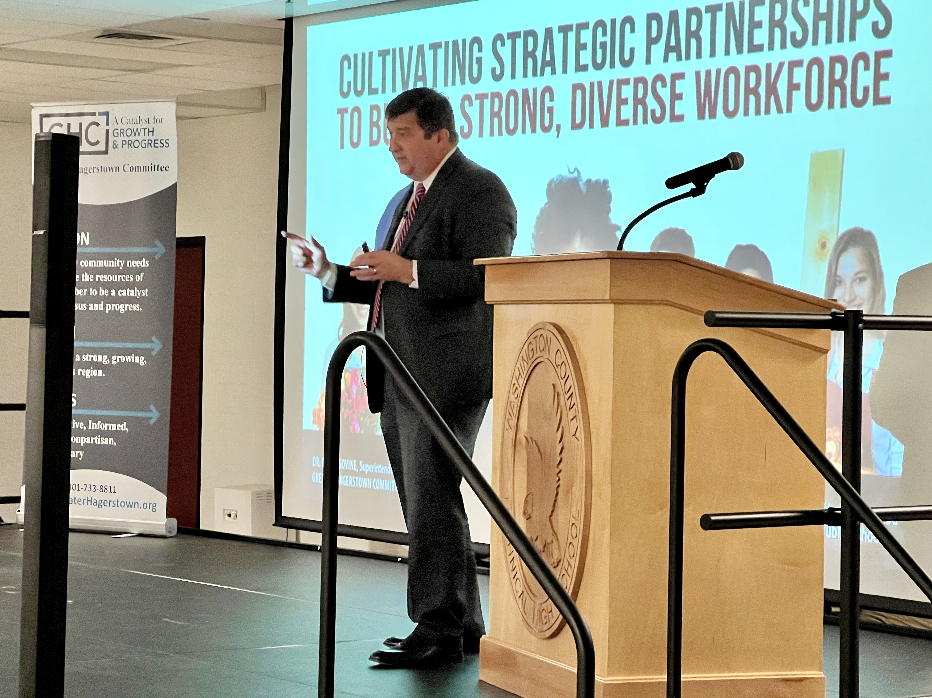
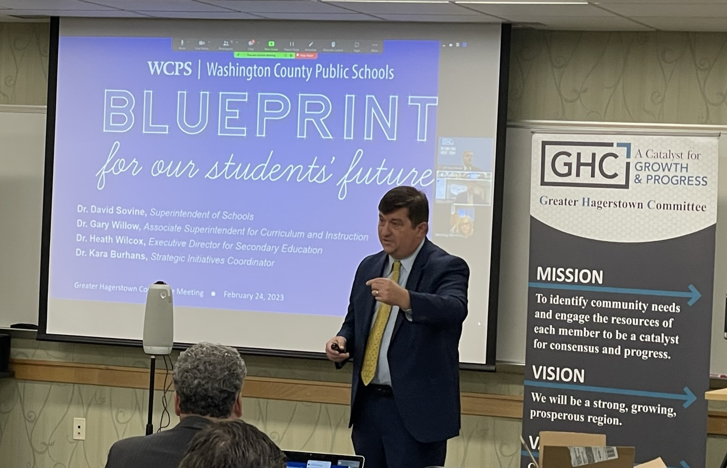
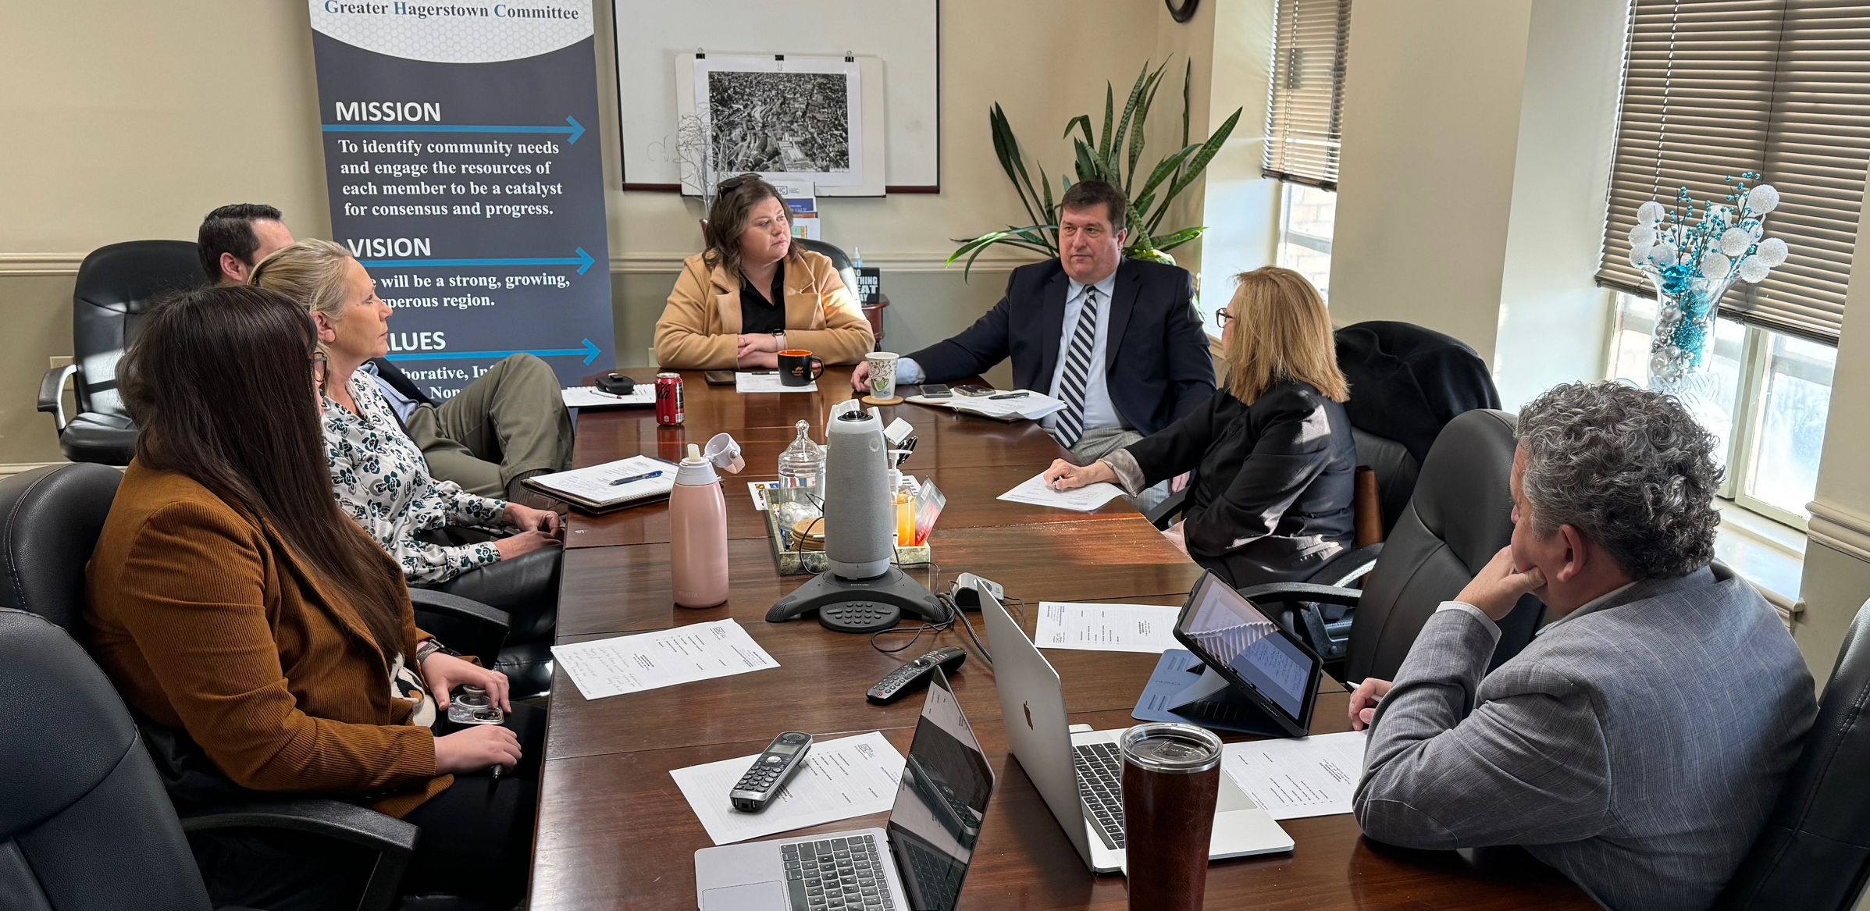
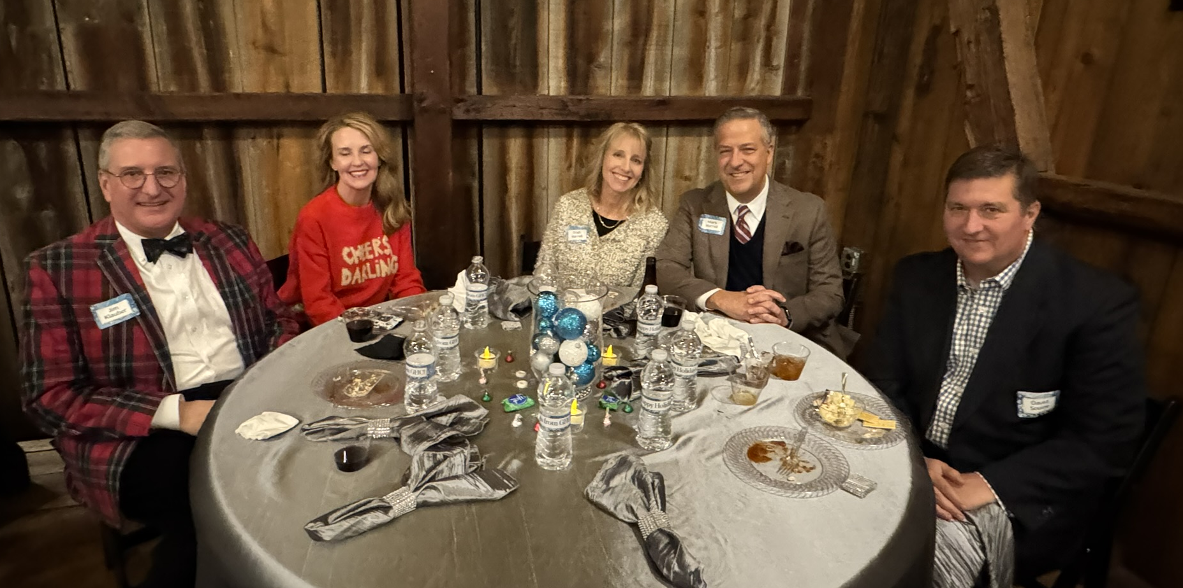
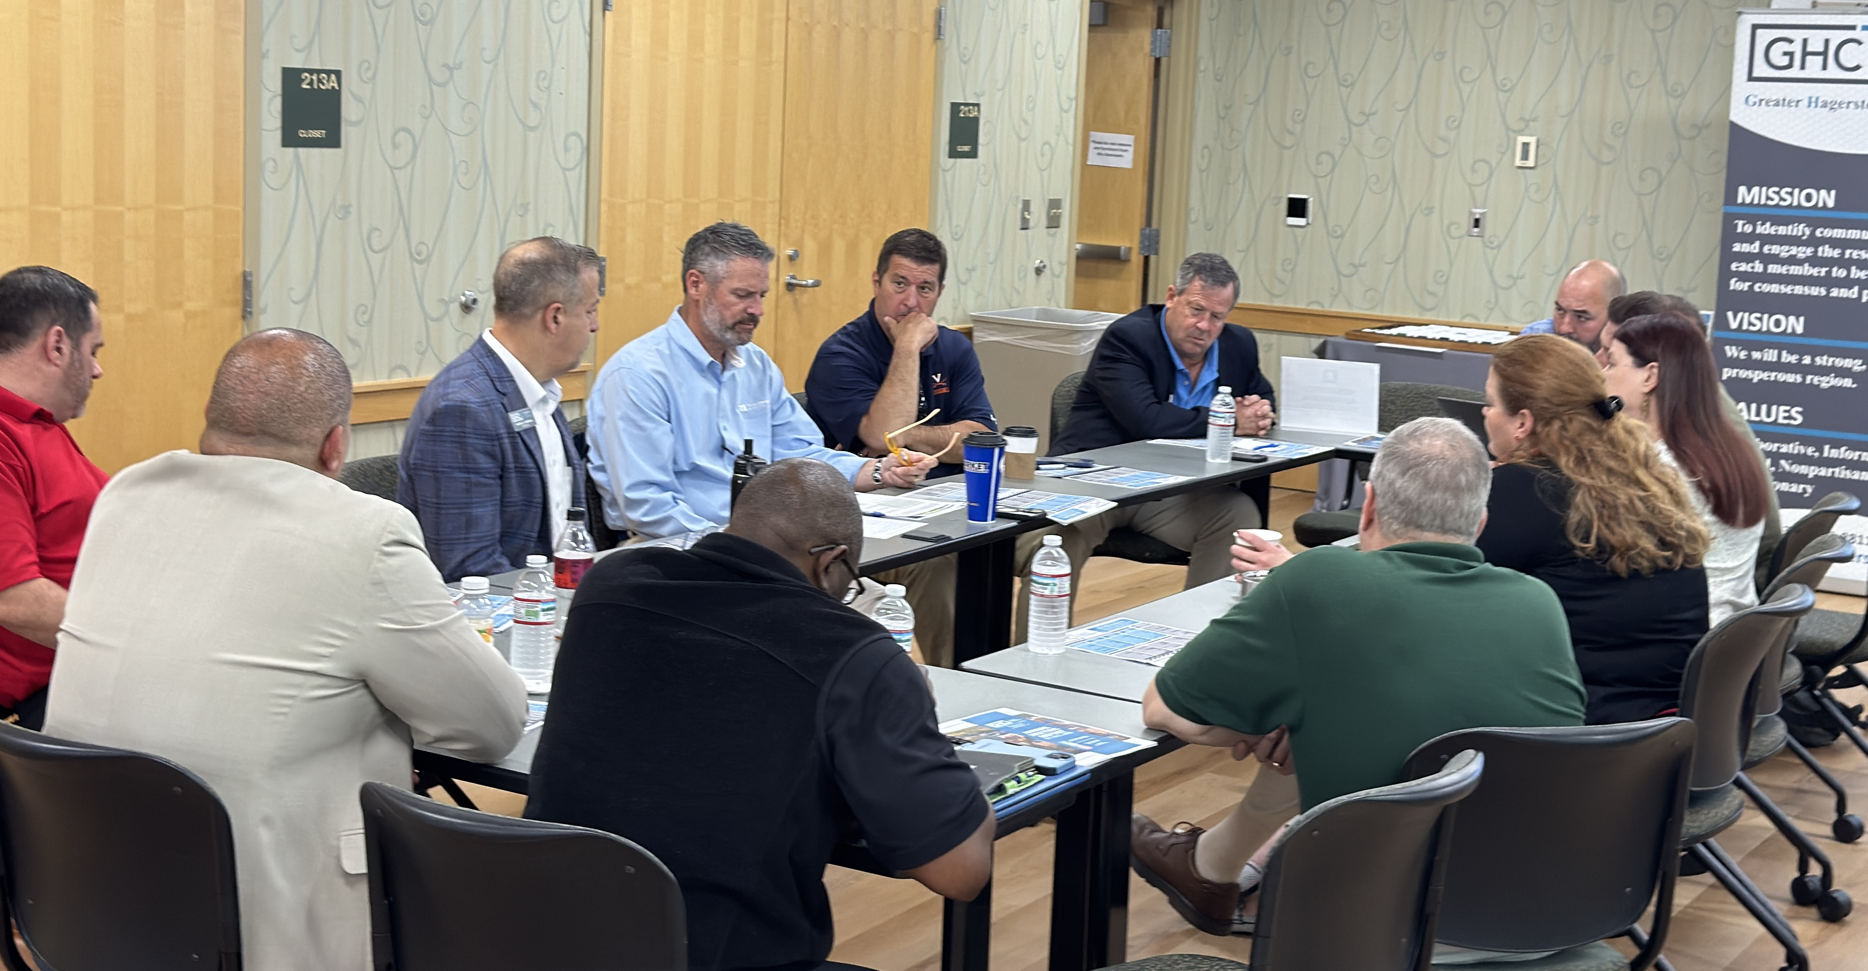
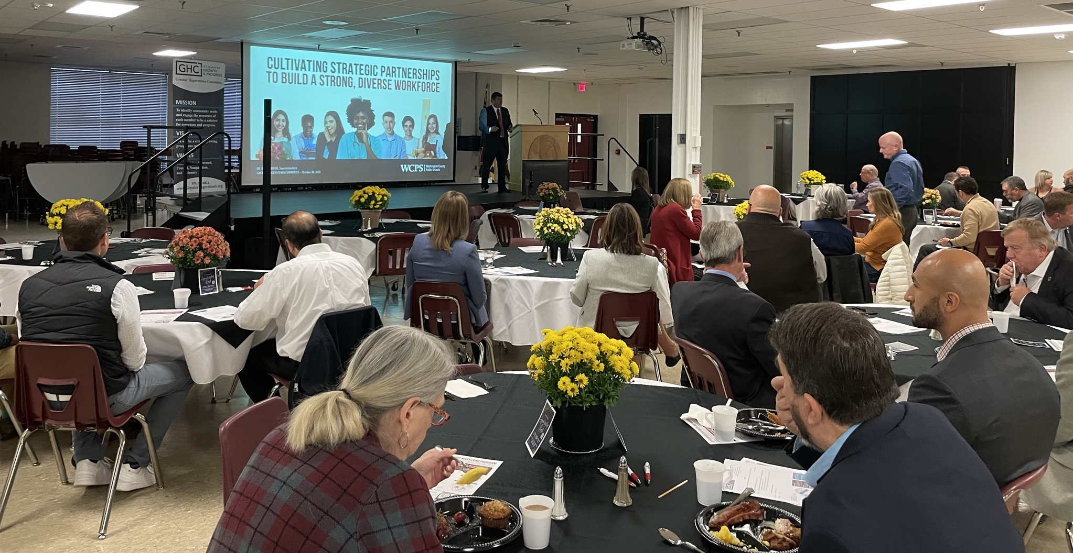
GHC Monthly Meeting June 2026
Special Appreciation
Thank You!!

Slide 6
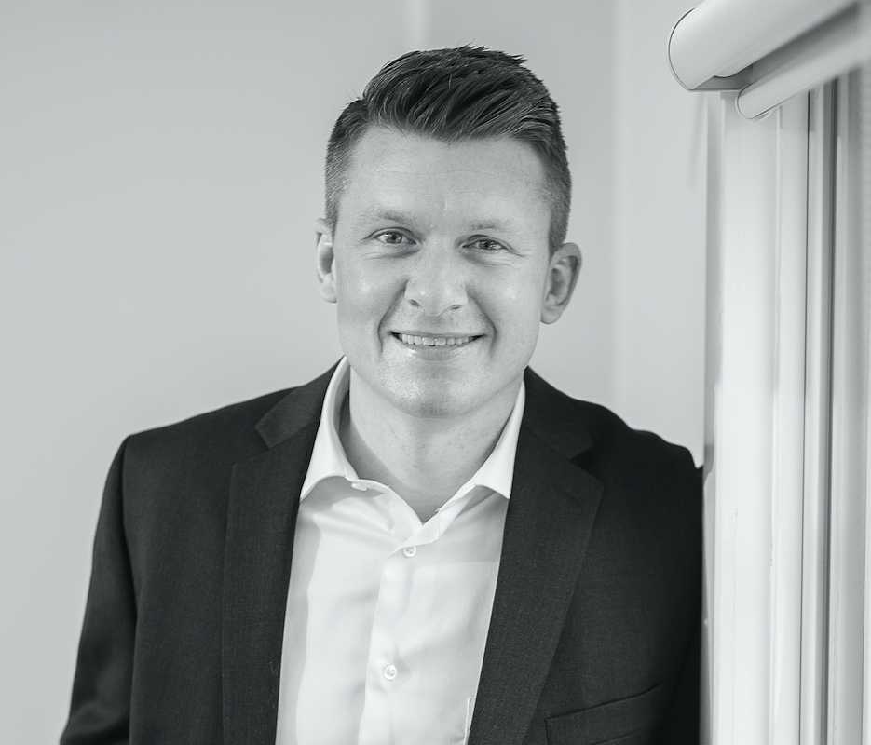

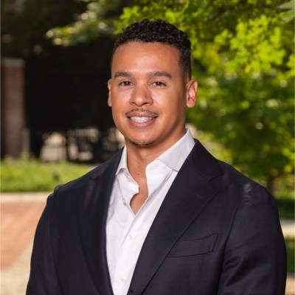

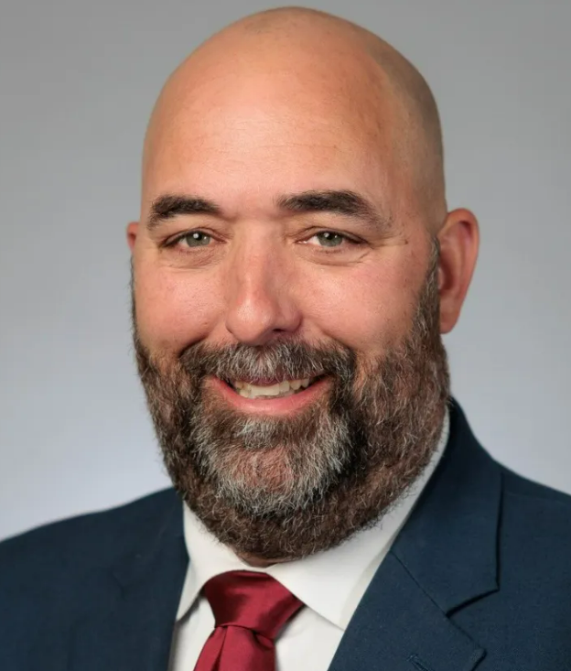

GHC Monthly Meeting June 2026
Please Welcome Prospective GHC Member
Josh Barnhart
Bowers Insurance
President, Partner
1380 Dual Highway
Hagerstown, MD 21740
Glen Martín
M.S. Johnston Company
CEO
13261 Pennsylvania Avenue
Hagerstown, MD 21742
Gary Willow (new member 7/1)
Washington County Public Schools
Superintendent
10435 Downsville Pike
Hagerstown, MD 21740

Slide 7

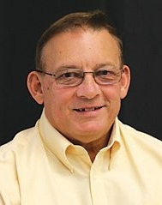
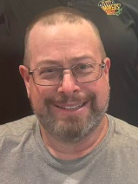
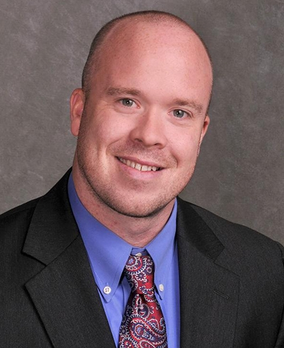
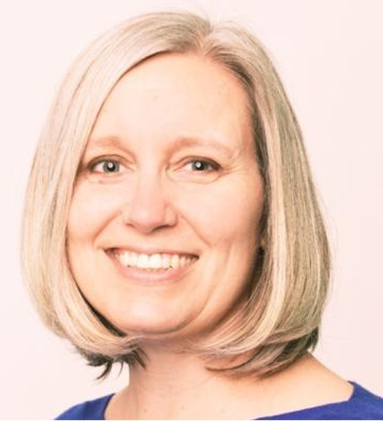
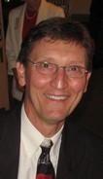
Please Welcome Today’s Panel
Jerry Spessard
Hagerstown Rotary Club
Past President
Jim McCleaf
Alsatia Club, Inc.
Past President and Current Treasurer
Darrell Evans
Antietam Exchange Club of Hagerstown
President
Katie Clark
Kiwanis Club of Hagerstown
Vice President
Tim Foltz
Hagerstown Lion’s Club
International Foundation Coordinator
Brad Kegarise
Downsville Ruritan Club
President

Slide 8

GHC Monthly Meeting June 2026

Slide 9

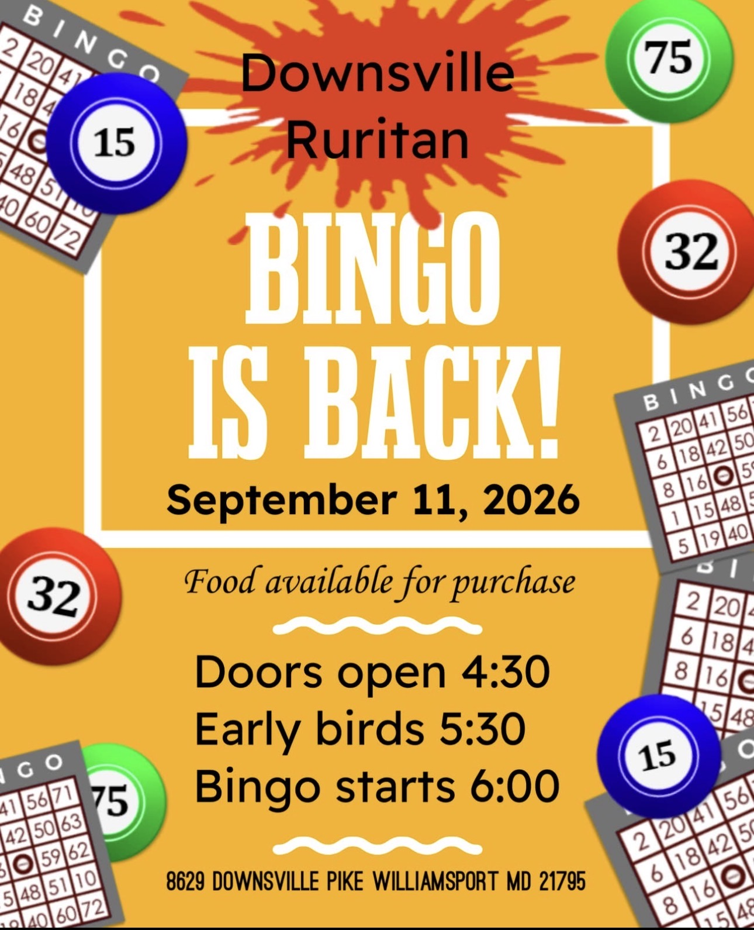
GHC Monthly Meeting June 2026
Upcoming Downsville Ruritan Events:

Slide 10
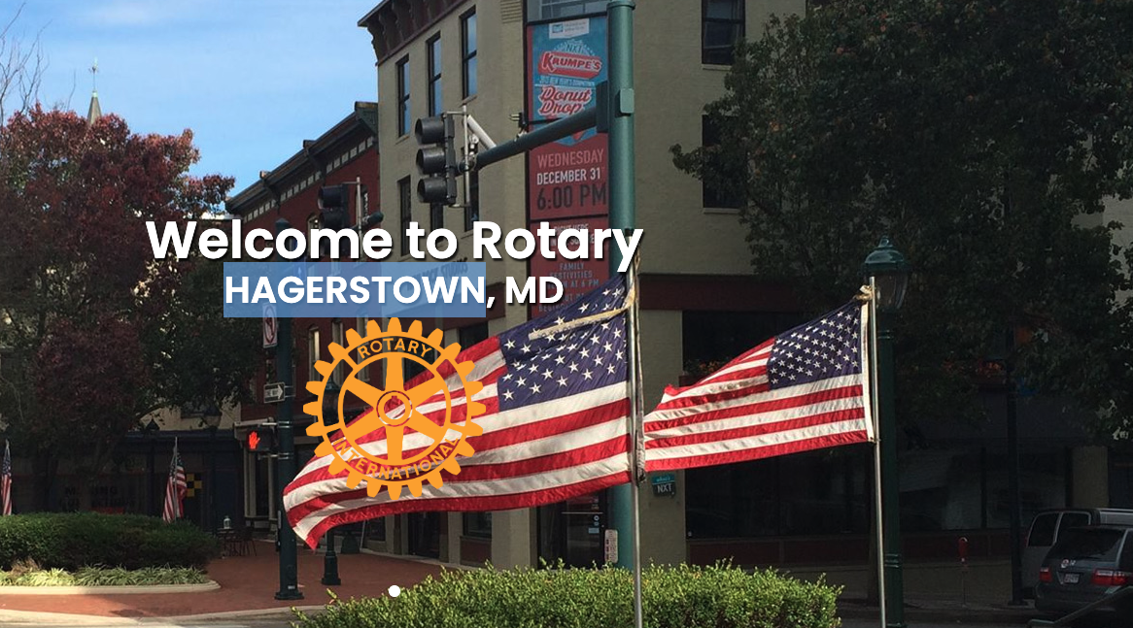


GHC Monthly Meeting June 2026
Upcoming Rotary Events:
Hagerstown Rotary Club
Community Service Mixer
with the Washington County Chamber of Commerce
Morris Frock American Legion Post 42
Finger food Cash bar 50/50 raffle
Connect. Serve. Network.
Wednesday, July 22nd
4:30-6:00 PM
See you there!

Slide 11
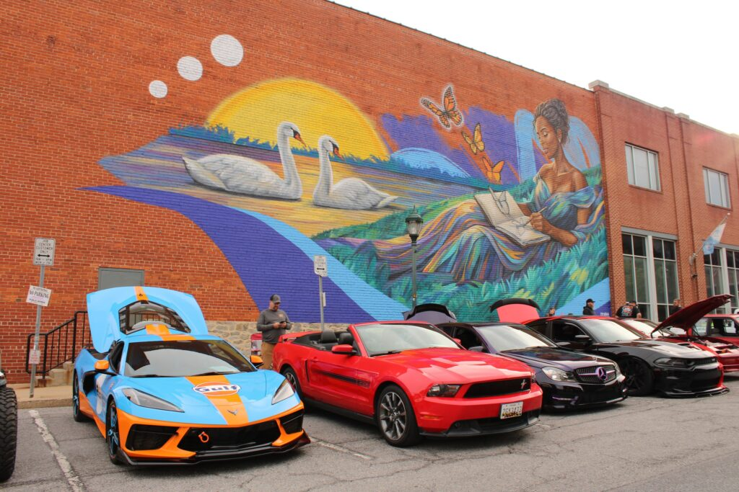
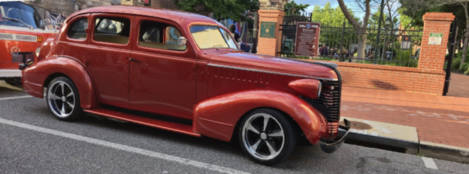
GHC Monthly Meeting June 2026
Upcoming Alsatia Club Event:
Alsatia Club Event:
Fall Thunder in the Square
Friday, September 25, 2026
Downtown Hagerstown 442 S. Potomac Street, Hagerstown, MD, United States
🌧 Rain Date: Friday, October 2, 2026
🚗 ALL VEHICLES WELCOME:
Jeeps • Cars • Trucks • Street Rods

Slide 12
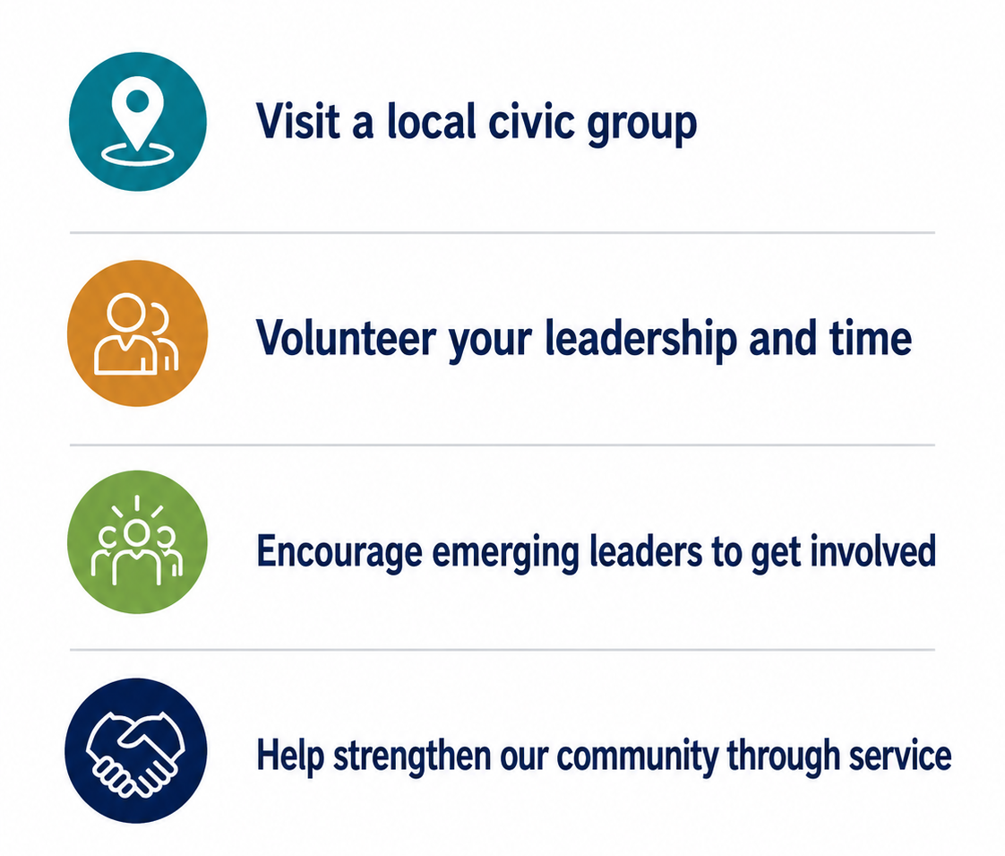
Call To Action
GHC Monthly Meeting June 2026
Summer Call to Action
This summer, we encourage GHC members to visit a local civic organization and explore how they can invest their leadership and time in service to the community
Visit a local civic group
Volunteer your leadership and time
Encourage emerging leaders to get involved
Help strengthen our community through service

Slide 13
Local Civic & Service Club Information:
You can find this chart in your meeting packet and
on the GHC website under the publications tab

Slide 14
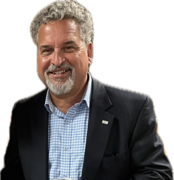
GHC Monthly Meeting June 2026
Executive Director’s Report
GHC Forum & Committees
(see meeting packet for status updates)

Slide 15
GHC Monthly Meeting June 2026
GHC Forum & Committee Chairs:
Alan Mullendore – Education Forum
  Meets 2nd Thursday of every other month, GHC Office w/ Zoom option
  Next meeting: Thursday, July 9th, 8:00 a.m. – Hybrid
  Collaborates with schools, colleges, and workforce organizations to strengthen education and employment opportunities in the Greater Hagerstown area.
Brad Fulton – Transportation Forum
  Usually Meets 3rd Monday of month or as needed, GHC Office or Zoom
  Next meeting: Monday, September 21st, 8:00 a.m. – Hybrid (tentative)
  Reviews and advises on regional transportation plans to address growth, traffic, environmental concerns, and economic development.

Slide 16
GHC Monthly Meeting June 2026
GHC Forum & Committee Chairs:
Steven Stitely – Vision Forum
  Meets 4th Wednesday of each month, GHC Office or ZOOM
  Next meeting: Wednesday, July 22nd, 8:00 a.m. – Hybrid
  Serves as GHC’s think tank, developing long-term goals and fostering collaborative efforts to shape the future of the region.
Julie Rohm – Downtown Enhancement Committee
  Meets 3rd Wednesday of month, GHC Office or Zoom
  Next meeting: Wednesday, July 15th, 8:00 a.m. – Hybrid
  Works to revitalize downtown areas by promoting housing diversity, industry hubs, and catalytic development projects.

Slide 17
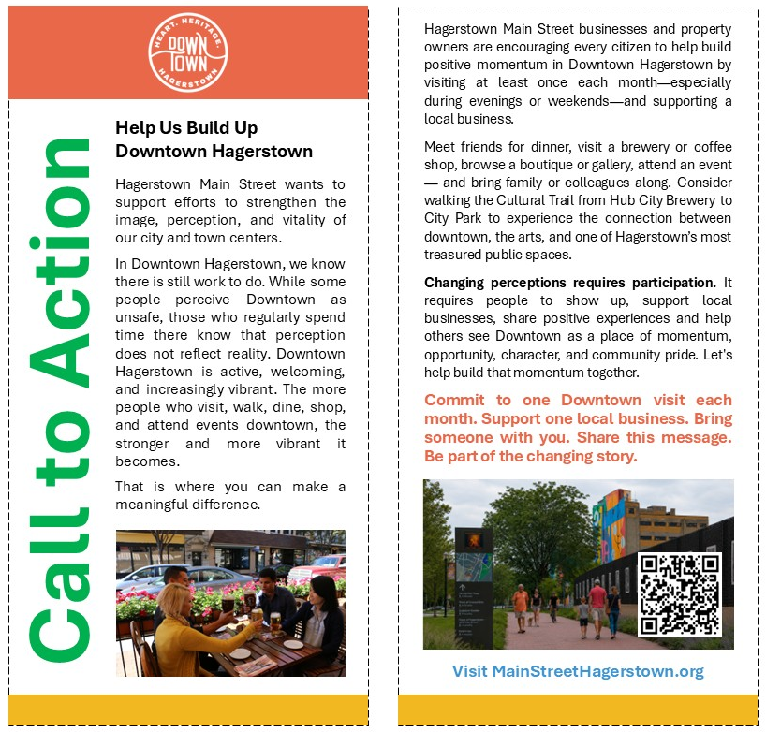
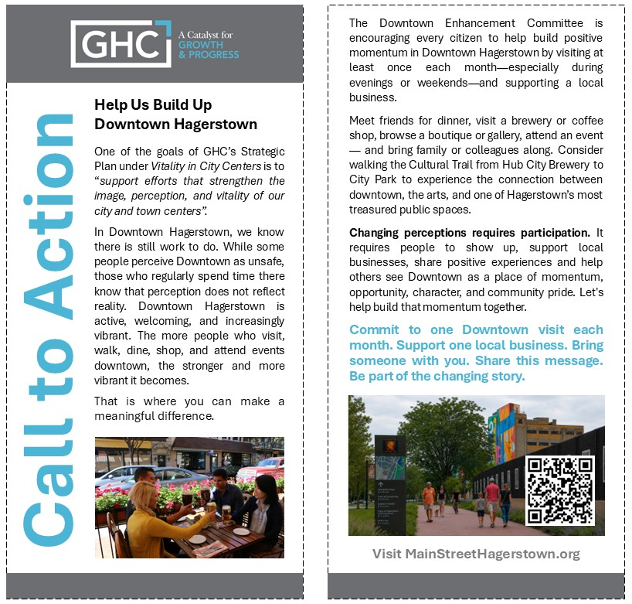
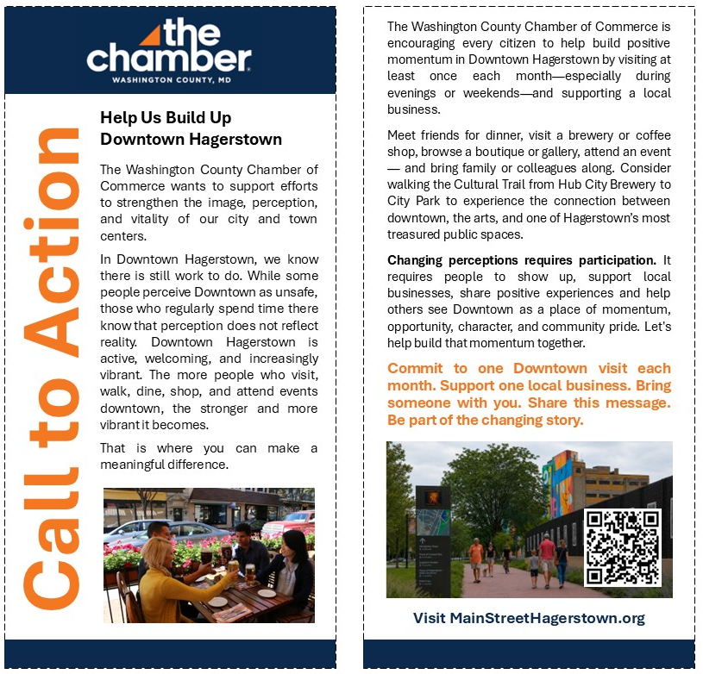
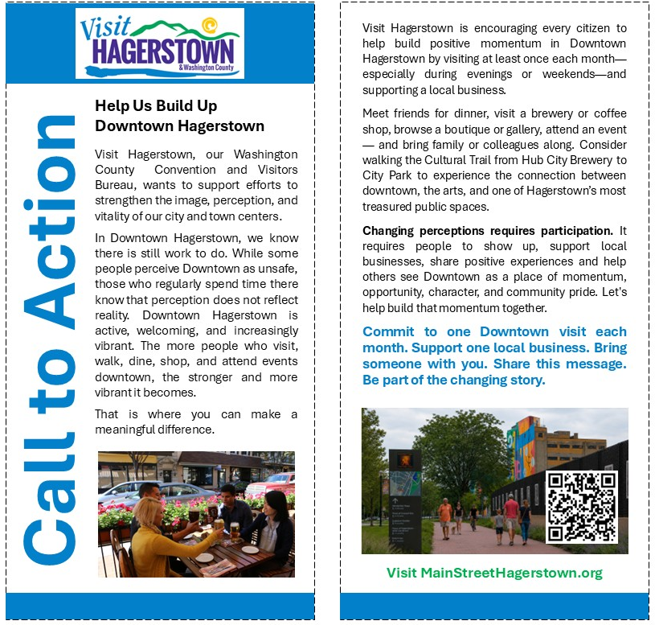
GHC Monthly Meeting June 2026
CALL TO ACTION
GHC’s Downtown Enhancement Committee and its partners invite you to share these cards with your networks and display them in your business.
If you would like a card created with your branding,
please reach out to GHC Staff GHCAdmin@greaterhagerstown.org

Slide 18
GHC Monthly Meeting June 2026
Announcements and Upcoming GHC Events

Slide 19
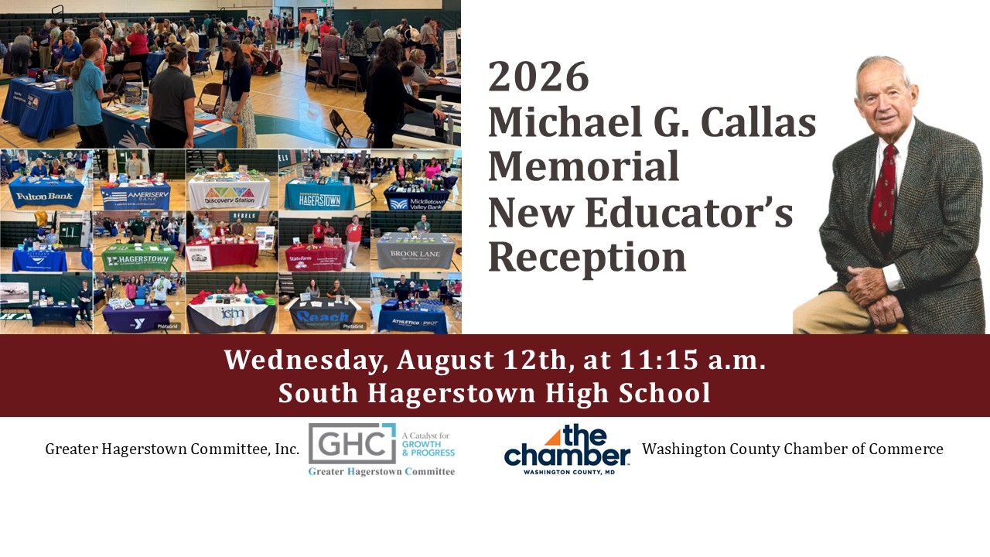
GHC Monthly Meeting June 2026
Upcoming Events:
Michael G. Callas Memorial New Educators Reception
12 Vendor Spaces
LEFT

Slide 20

GHC Monthly Meeting June 2026
Upcoming Events:
Enjoy your summer break as there are no Monthly Meetings in July or August
(Forums/Committees will still meet in summer)
Next GHC Monthly Meeting:
Friday, September 25th, 2026
HCC CPB Rooms 211/213
7:30 a.m. to 8:30 a.m.

Slide 21
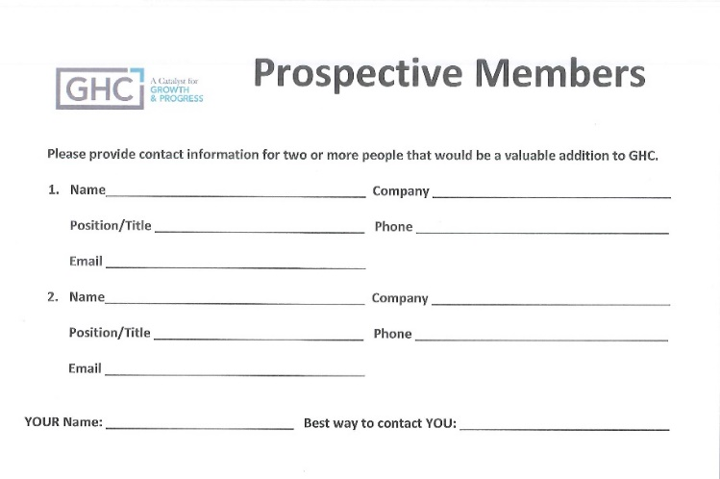
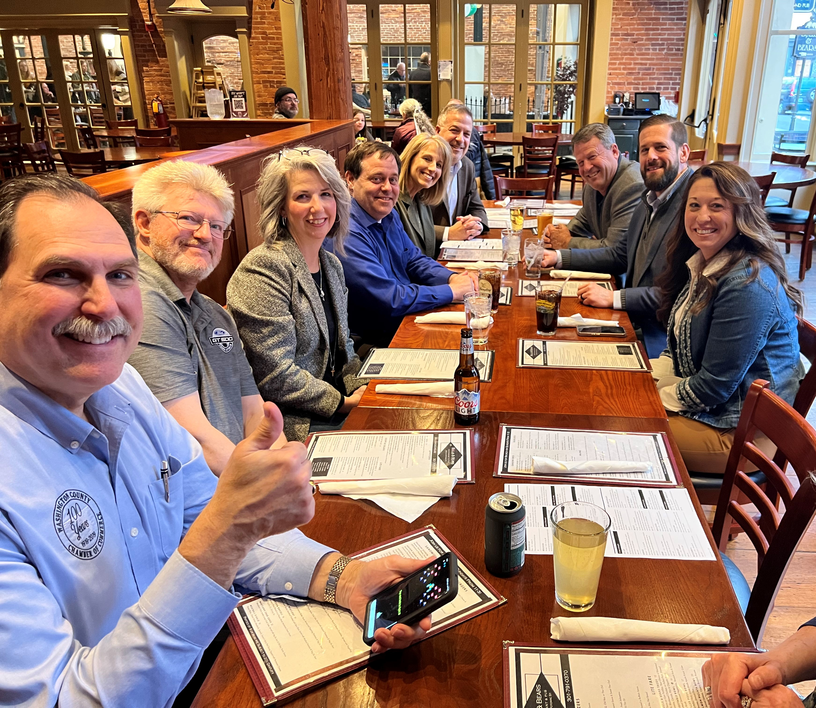
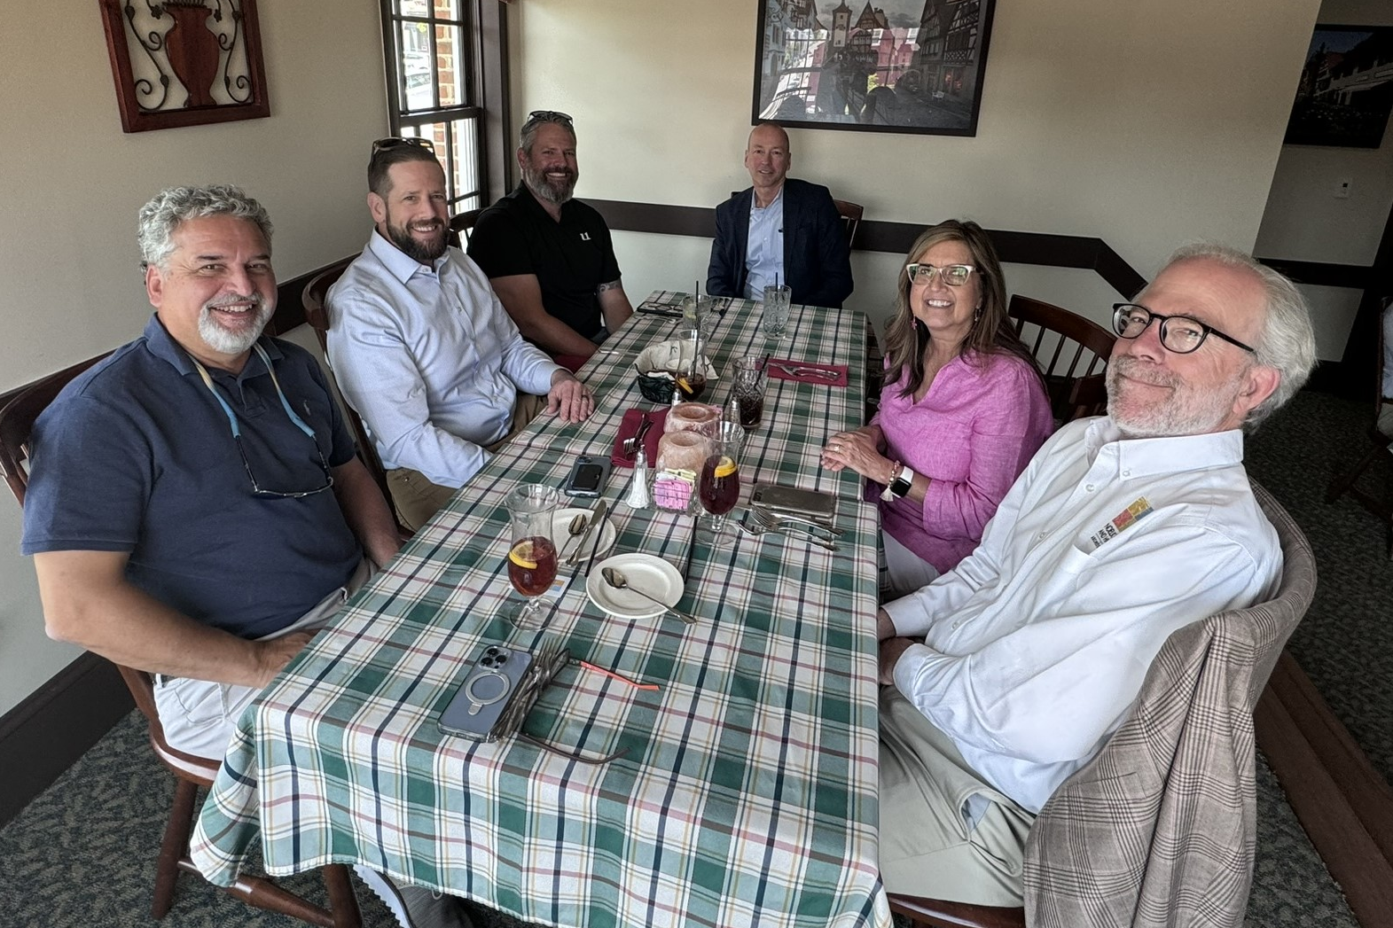
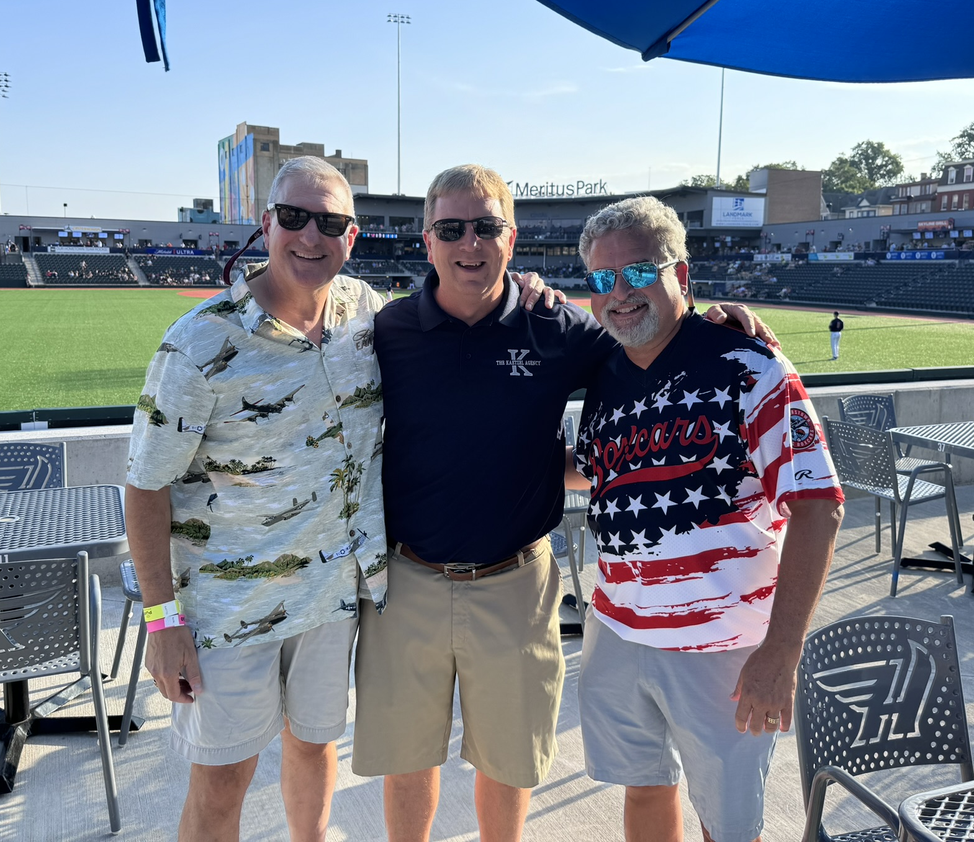
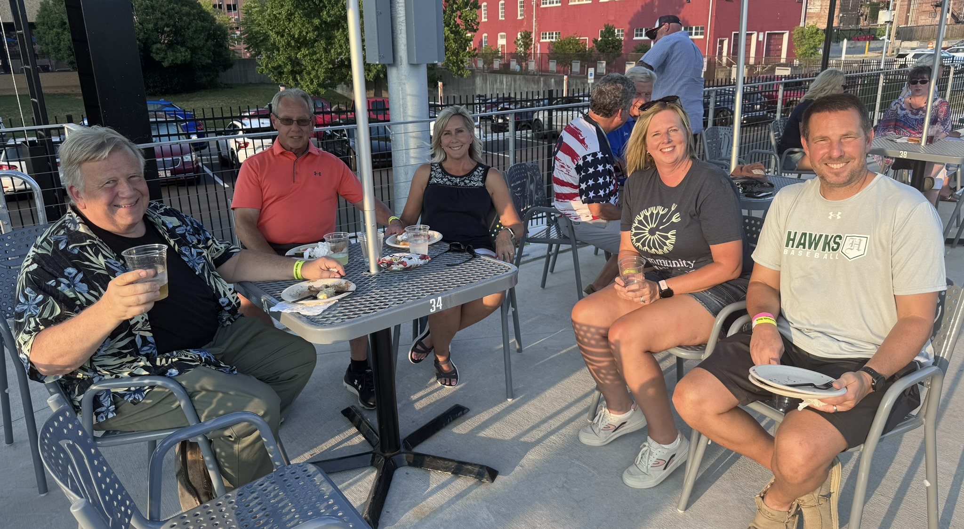
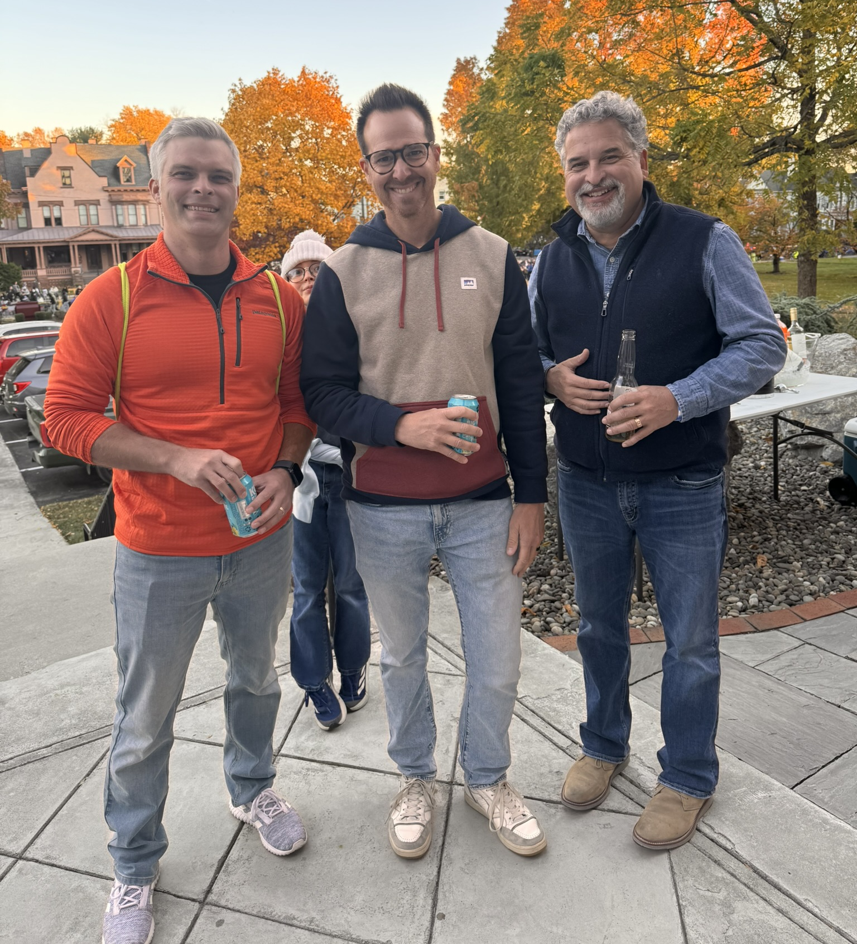





GHC Monthly Meeting June 2026
GHC Prospective Members
Do you know someone who would
be a valuable addition to GHC?
Contact Membership Committee Chair
Michael Weiss at mweiss6252@gmail.com
Visit NEW Tab
on our Website “How to Join”

Slide 22

GHC Monthly Meeting June 2026
GHC Monthly Meeting September 2022
Networking Session
Please Welcome New GHC Members
Please feel free to stay after
the meeting for 30 minutes of GHC Member networking time
NETWORKING
OPPORTUNITY

Slide 23

Adjourned
GHC Monthly Meeting June 2026
Happy
Summer
Holiday

