Slide 1
Division of Emergency Services
February 2019
Washington County, Maryland
Staffing Plan

Slide 2
Overview
Washington County, Maryland
Staffing Plan
Where are current numbers?
What do these numbers tell about the current needs?
washco-md.net
February 2019

Slide 3
Fail Rates
Washington County, Maryland
Staffing Plan
DES Staffing begins to staff VFDs March 2018
BOCC Brief on Volunteer Quarterly Fail Rates per RS-2014-17 & Incident Response Staffing
 |  | 2015 |  |  |  | 2016 |  |  |  | 2017 |  |  |  | 2018
 | 1st QT | 2nd QT | 3rd QT | 4th QT | 1st QT | 2nd QT | 3rd QT | 4th QT | 1st QT | 2nd QT | 3rd QT | 4th QT | 1st QT | 2nd QT | 3rd QT | 4th QT
Co. 1 - Sharpsburg | 0.0% | 2.7% | 6.5% | 2.5% | 1.2% | 2.9% | 4.5% | 1.4% | 1.4% | 3.9% | 3.3% | 1.6% | 0.0% | 2.0% | 0.0%
Co. 2 - Williamsport | 0.9% | 0.9% | 0.8% | 1.2% | 0.0% | 2.5% | 0.9% | 0.0% | 0.0% | 0.5% | 0.4% | 0.5% | 0.9% | 0.9% | 0.0%
Co. 4 - Clear Spring | 2.9% | 3.7% | 0.0% | 2.5% | 0.0% | 1.0% | 0.0% | 1.6% | 0.9% | 2.4% | 0.9% | 1.0% | 1.5% | 0.0% | 0.0%
Co. 5 - Hancock | 2.6% | 4.6% | 0.9% | 4.5% | 1.5% | 2.9% | 0.6% | 0.0% | 1.4% | 1.5% | 2.8% | 0.0% | 0.0% | 2.7% | 2.8%
Co. 6 - Boonsboro | 3.2% | 4.5% | 1.8% | 1.9% | 2.2% | 1.7% | 0.0% | 2.8% | 5.4% | 1.8% | 1.1% | 0.8% | 1.4% | 1.9% | 0.0%
Co. 7 - Smithsburg | 4.0% | 2.9% | 2.7% | 9.2% | 2.2% | 1.7% | 4.4% | 1.6% | 1.8% | 5.7% | 1.2% | 1.7% | 0.0% | 1.6% | 2.2%
Co. 8 - Rohresville | 0.9% | 1.3% | 3.8% | 2.5% | 4.2% | 0.0% | 3.9% | 4.8% | 3.6% | 2.5% | 5.9% | 0.0% | 4.0% | 0.8% | 4.5%
Co. 9 - Leitersburg | 0.0% | 1.1% | 1.5% | 0.0% | 0.0% | 1.9% | 1.0% | 1.9% | 0.0% | 0.0% | 2.6% | 0.0% | 1.0% | 0.0% | 2.8%
Co. 10 - Funkstown | 2.8% | 2.9% | 4.7% | 2.7% | 3.0% | 2.0% | 1.9% | 0.7% | 0.0% | 0.3% | 0.0% | 0.0% | 0.0% | 0.0% | 0.0%
Co. 11 - Potomac Vly | 5.4% | 4.8% | 2.9% | 12.1% | 3.2% | 0.0% | 2.3% | 5.6% | 3.0% | 5.6% | 5.0% | 0.0% | 3.6% | 2.1% | 1.1%
Co. 12 - Fairplay | X | X | X | X | X | X | X | X | 1.0% | 1.1% | 5.0% | 2.2% | 4.5% | 5.1% | 5.0%
Co. 13 - Maugansville | 2.3% | 0.0% | 4.2% | 2.1% | 1.8% | 1.5% | 1.1% | 0.9% | 1.6% | 1.5% | 0.0% | 1.9% | 0.5% | 1.2% | 0.0%
Co. 16 - Mt. Aetna | 0.0% | 2.5% | 2.1% | 0.0% | 4.5% | 4.3% | 3.1% | 2.7% | 2.0% | 3.0% | 5.0% | 0.0% | 1.1% | 4.2% | 1.0%
Co. 26 - Halfway | 2.7% | 4.1% | 4.4% | 7.2% | 3.1% | 0.0% | 0.4% | 0.4% | 0.4% | 1.2% | 1.1% | 0.0% | 0.0% | 0.4% | 0.0%
Co. 27 - Longmeadow | 0.5% | 0.0% | 0.6% | 0.5% | 2.0% | 1.6% | 0.6% | 0.0% | 0.0% | 0.0% | 0.0% | 0.0% | 0.6% | 0.7% | 0.0%
Phase 1 of the staffing plan has had a minimal effect on the system. Understaffed and Driver Only responses continue to increase.
washco-md.net
February 2019
Notes:
Get 4th Q 2018 stats into document

Slide 4
Staffing
Washington County, Maryland
Staffing Plan
**May 2016 – Apparatus staffing standard lowered; from minimum of 4 certified FFs to 3 FFs
washco-md.net
February 2019

Slide 5
‘Light’ and ‘Driver Only’ Statistics
Washington County, Maryland
Staffing Plan
washco-md.net
February 2019
Notes:
Update graph for 4th Q 2018

Slide 6
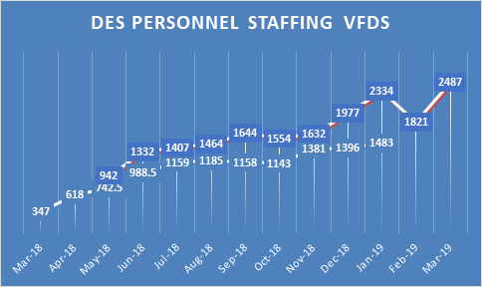
DES Personnel Staffing
Washington County, Maryland
Staffing Plan
washco-md.net
February 2019

Slide 7
Current Overview
Washington County, Maryland
Staffing Plan
Where are we now?
washco-md.net
February 2019

Slide 8
Where are we now?
Washington County, Maryland
Staffing Plan
$7,156,680
VOLUNTEER
FIRE
EMS
washco-md.net
February 2019

Slide 9
Volunteer Fire & EMS
Washington County, Maryland
Staffing Plan
$5,876,080
$1,280,600
Appropriations to Companies
Workers Compensation
Insurance (vehicle, property, casualty)
LOSAP Length of Services Awards Program
Firehouse Software
Medical Fees (Volunteer Physical)
Other Insurance
Volunteer Stipend & Programs
washco-md.net
February 2019
Notes:
Move property and vehicle insurance over to other category and change total cost of that category

Slide 10
Indirect Contributions
Washington County, Maryland
Staffing Plan
Funding yearly ladder, pump and hose testing ($90,000.00)
Cardiac monitor/ defibrillator maintenance contracts ($75,000.00)
1 Full-time position for a Recruitment and Retention Coordinator (works directly for Washington County Volunteer Fire and Rescue Association) $67,500.00
Indirect Contributions
washco-md.net
February 2019

Slide 11
Locations
Washington County, Maryland
Staffing Plan
15 County Volunteer Fire Stations
Sharpsburg Volunteer Fire Co.
Williamsport Volunteer Fire and EMS
Clear Spring Volunteer Fire Co.
Hancock Volunteer Fire Co.
First Hose Company of Boonsboro
Boonsboro Rhorersville Station 8
Smithsburg Volunteer Fire Co.
Leitersburg Volunteer Fire Co.
Funkstown Volunteer Fire Co.
Potomac Valley Volunteer Fire Co.
Community Volunteer Fire Co. District 12
Maugansville Volunteer Fire Co.
Mt Aetna Volunteer Fire Co.
Volunteer Fire Company of Halfway
Longmeadow Volunteer Fire Co.
5 City Volunteer Fire Stations/Hagerstown Fire Department
First Hagerstown Hose Co.
Antietam Volunteer Fire Co.
Independent Juniors Volunteer Fire Co.
& Pioneer Hook and Ladder Co.
Western Enterprise Volunteer Fire Co.
South Hagerstown Volunteer Fire Co.
Hagerstown Fire Department (Headquarters)
washco-md.net
February 2019

Slide 12
Fire
Washington County, Maryland
Staffing Plan
Direct General Financial Contributions
Firefighter Staffing Subsidy
$48,000
County Stations
$24,000
City Stations
$25,000
County Stations
washco-md.net
February 2019
Notes:
Add “to each” county station and the same for city station. Do the same for the $25,000 category. Alo, consider changing the wording for Direct to; Direct General Financial Contributions for general operating expenses. Consider changing wording on subsidy to; Staffing Subsidy for corporation employees.

Slide 13
Locations
Washington County, Maryland
Staffing Plan
8 County EMS Stations
Sharpsburg Ambulance
Clear Spring Ambulance
Hancock Ambulance
Boonsboro Ambulance
Community Rescue Service
Smithsburg Ambulance
Williamsport Volunteer Fire and EMS (fire and EMS are co-located)
Halfway Fire/EMS (fire and EMS are co-located)
washco-md.net
February 2019

Slide 14
EMS
Washington County, Maryland
Staffing Plan
Direct General Financial Contributions
Firefighter Staffing Subsidy
EMS Staffing Subsidies
$48,000
County Stations
$25,000
2 EMS Stations
$2,026,000
washco-md.net
February 2019
Notes:
Change to Rescue Squad Staffing Subsidy

Slide 15
Volunteer Incentives
Washington County, Maryland
Staffing Plan
CURRENT
PROPOSED
Tuition Stipend Program
LOSAP (Length of Services Awards Program)
Income Tax Subtraction Modification
Additional Cash
Mobile Phone
Life Insurance
Other Ideas??
washco-md.net
February 2019
Notes:
The word “Program” is cut off.

Slide 16
Future Outlook
Washington County, Maryland
Staffing Plan
EMS MASTER PLAN (Staffing)
(currently under consideration)
Phase One
Phase Two
2009
Hire full and part-time staff
(October 2017)
County staffing at EMS Stations
washco-md.net
February 2019

Slide 17
EMS MASTER PLAN – PHASE TWO
Washington County, Maryland
Staffing Plan
108 EMS Staff Needed
Up to:
$8,716,384.34
Recoverable Revenue from previous EMS subsidy and EMS billing (80%)
$6,272,554.64
$2,443,829.70
washco-md.net
February 2019

Slide 18
Future Outlook
Washington County, Maryland
Staffing Plan
STRATEGIC FIREFIGHTER STAFFING PLAN
Phase One
Phase Two
Phase Three
Phase Four
Phase Five
8 Full-time Firefighters located at Special Ops
23 Part-time Firefighters
60 Full-time Firefighters
(one firefighter at each volunteer fire company)
2 Full-time Battalion Chiefs
SAFER Grant
2nd Firefighter at 8 stations
(32 firefighters)
2nd Firefighter at remaining 7 stations
(28 firefighters)
Add 3rd Battalion Chief
3rd Firefighter at 3 stations
(12 firefighters)
washco-md.net
February 2019

Slide 19
Firefighter Staffing Plan – PHASE TWO
Washington County, Maryland
Staffing Plan
60 Firefighters
One firefighter at each fire station per 24 hour period
$4,597,164.00
washco-md.net
February 2019

Slide 20
Washington County, Maryland
Staffing Plan
Division of Emergency Services Budget
$1,364,180 Fire Operations
$1,466,970 EMS Operations
$258,810 Emergency Management
$4,843,110 911 Communications
$79,920 Special Operations
$38,430 Air Unit (ESS)
$7,156,680 Fire & Rescue Volunteer Services
Fiscal Year 2019 Budget
washco-md.net
February 2019

Slide 21
Challenges
Washington County, Maryland
Staffing Plan
Fail Rates
Staffing
Apparatus
Facilities
Sustainable Revenues
washco-md.net
February 2019

Slide 22
Questions
Washington County, Maryland
Staffing Plan
Follow Us:
R. David Hays
Director
Division of Emergency Services
Washington County, MD
240-313-4364
dhays@washco-md.net
WashingtonCountyMD
@WashingtonCoMD
WashingtonCountyMD
washco-md.net
February 2019

Slide 23
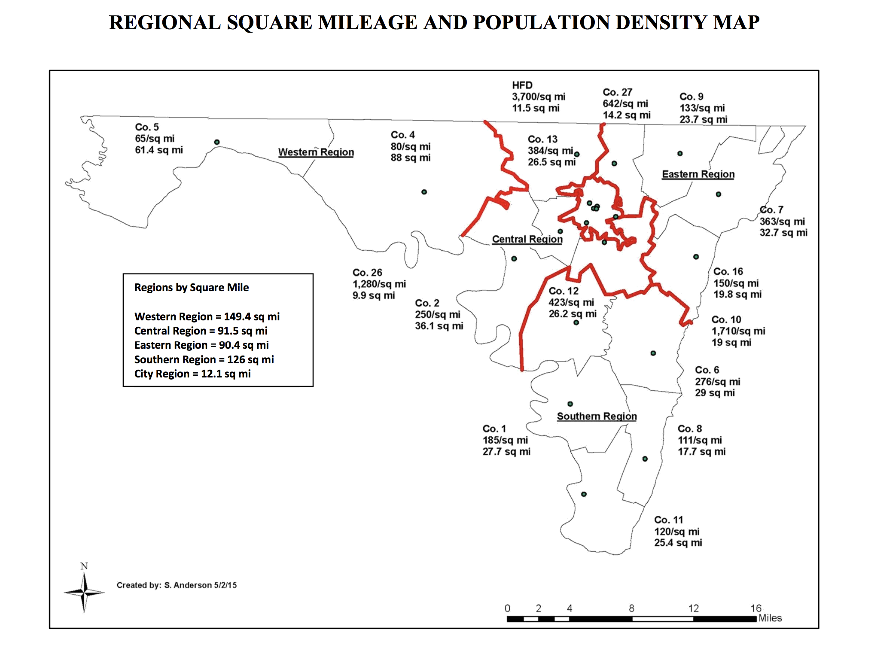

Slide 24
